Slide 1
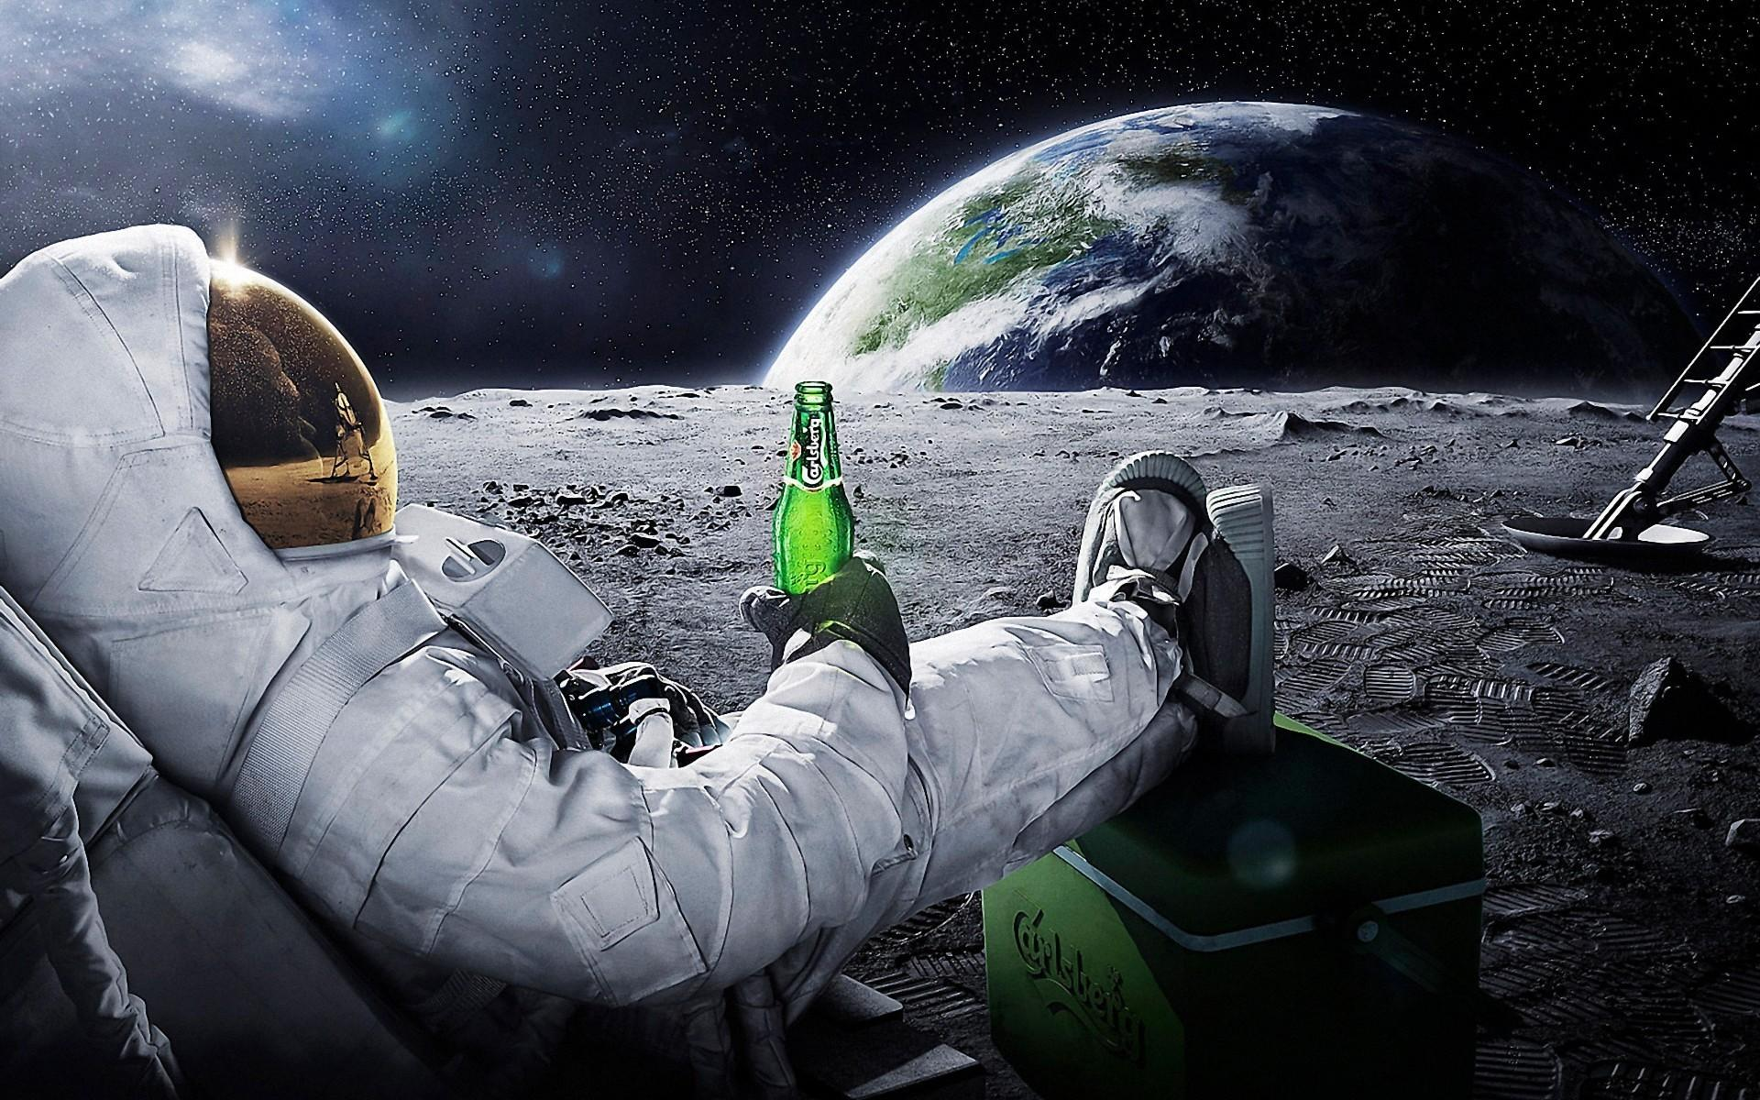
COSMIK
SEEING THE WORLD FROM
A NEW PERSPECTIVE

